Slide 1
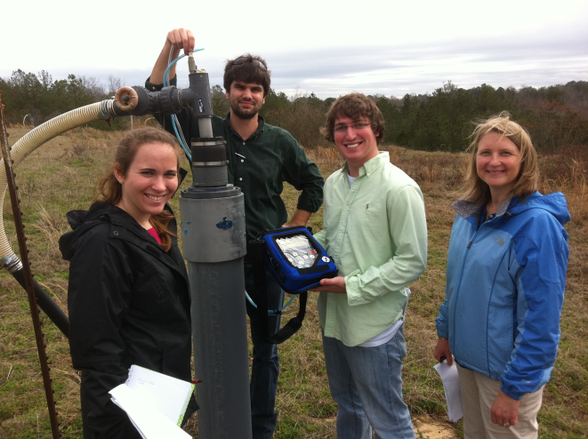


Feasibility of a Landfill Gas to Energy System For Sumter County, Georgia
University of Georgia Environmental Engineering Students
ENVE 2920, April 2012
Jennifer Wilson
Thomas Matthews
Justin Valle
Advisor: Dr. Jenna Jambeck

Slide 2
Objective
The objective of this study was to examine the technical and economic feasibility of a landfill gas-to-energy system at the closed landfill in Sumter County.
If a landfill gas-to-energy system is a possible option for Sumter County, it could be used to convert landfill gas (LFG) into a renewable source of energy to be used in the Sumter County community.

Slide 3
Landfill Gas Composition
The decomposition of waste in a landfill undergoes chemical and biological reactions that produce leachate and gas.
Composition of LFG
50% Methane
50% Carbon Dioxide
As well as negligible amounts of
Nitrogen
Oxygen
Hydrogen
Other non-methane organic compounds
LFG production reaches its peak soon after the landfill’s closure date

Slide 4
Landfill Gas Migration
Once LFG forms it travels and expands into pores or nearby available space within the landfill.
Pathways can follow unpredictable directions.
Methane Gas is less dense than air, and therefore has a tendency to migrate towards the surface of the landfill.
Horizontal gas migration occurs when the natural vertical migration of LFG is obscured.
The gas will continue to follow a horizontal path until its natural vertical migration is again possible.

Slide 5
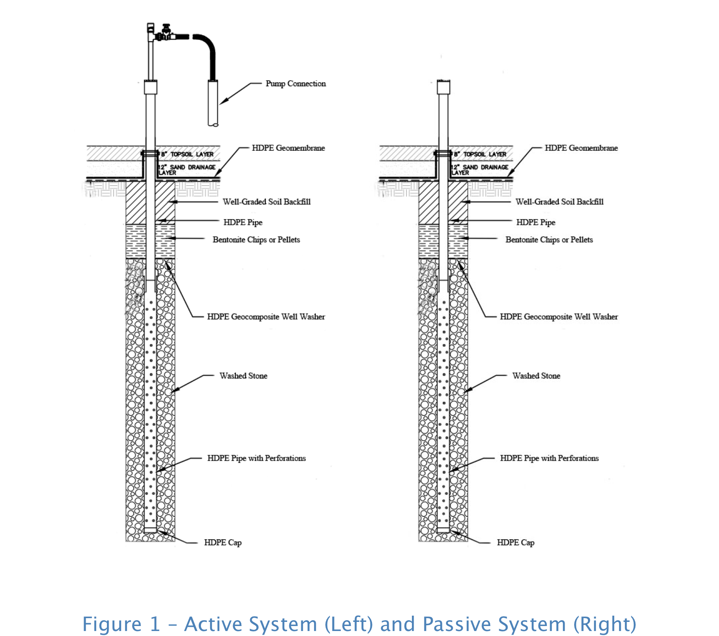
Landfill Gas Venting Systems
LFG can be controlled and collected by using either a passive system or an active system.
The difference between the two is that the active system employs the use of a pump to pull (vacuum) the LFG out of the landfill.
Federal/state regulations (New Source Performance Standards (NSPS)) determine if a landfill is required to have active or passive systems

Slide 6
Sumter County Landfill
Opened in 1987
Closed in 1995
During operation, this landfill collected approximately 172,000 metric tons of waste
Currently has 18 wells in place
10 passive vents (not required to have active collection under NSPS)
8 soil vapor extraction wells (modified passive vent)

Slide 7
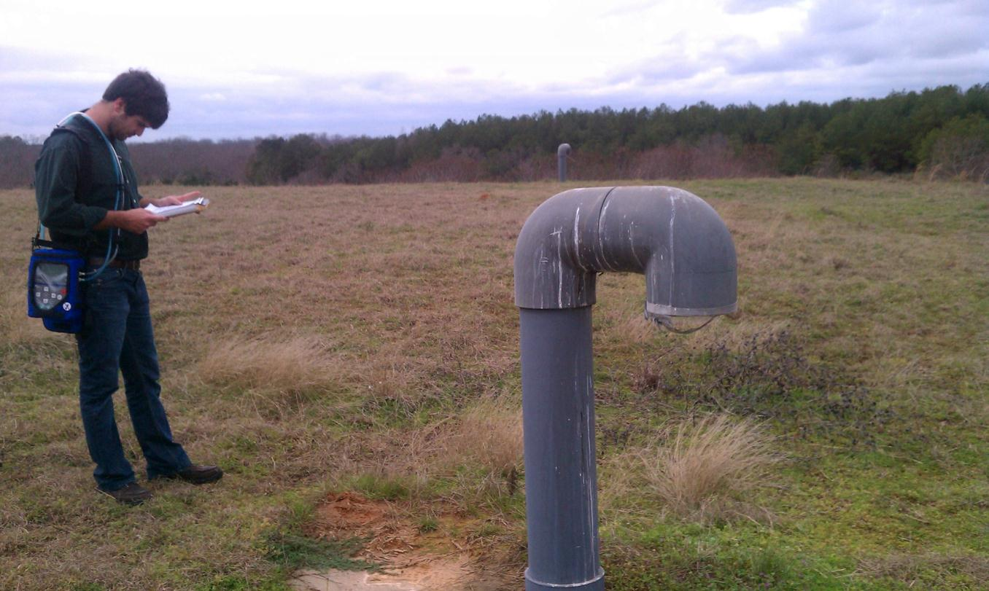
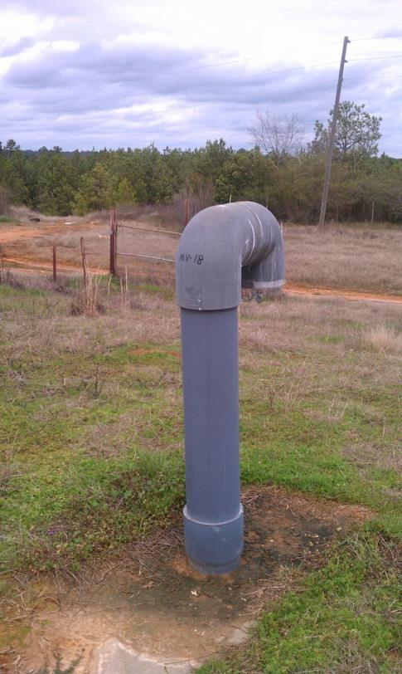
Passive LFG System at Sumter County Landfill

Slide 8
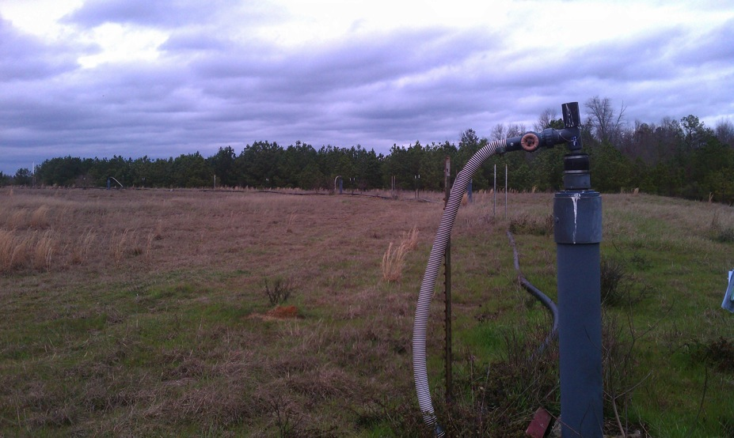
Soil Vapor Extraction System at Sumter County Landfill

Slide 9
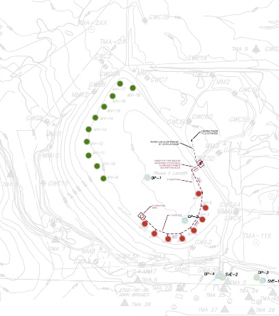
Map of Sumter County Landfill
(green = passive vents, red = soil vapor extraction wells)

Slide 10
Projected Landfill Gas Emissions for Sumter County
Peak LFG production occurred in 1996.
Peak total LFG flow rate = 155 cubic feet per minute (cfm)
Current total LFG flow rate = 69.7 cfm
This graph also reinforces that LFG production gradually decreases after a landfill’s closure date

Slide 11
Landfill Gas-to-Energy Systems
Electricity Generation
Internal Combustion Engines (ICE’s)
Gas Turbines
Micro Turbines
Direct Use
Alternative Fuels
Cogeneration

Slide 12
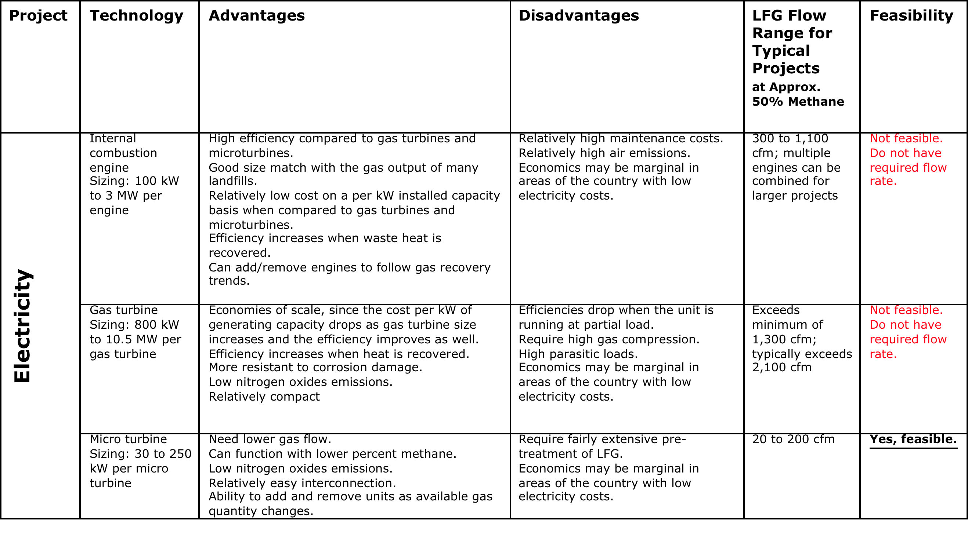
Feasibility of Electricity Generation LFG-to-Energy Systems

Slide 13
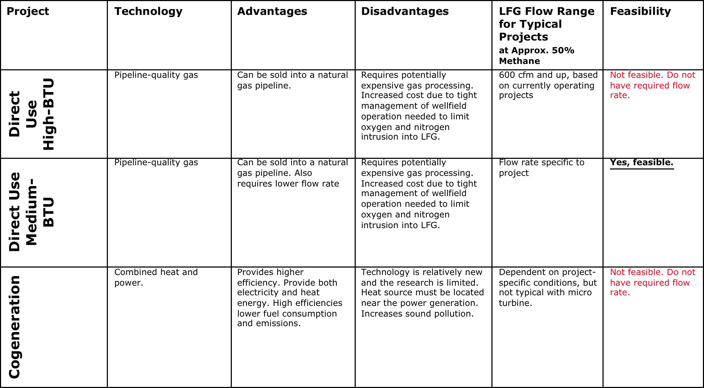
Feasibility of Direct Use, Cogeneration, and Alternative Fuels LFG-to-Energy Options

Slide 14
Technically Feasible Systems
The relatively low flow rate (65-70 cfm) of LFG is Sumter County’s major constraint for installing a LFG-to-energy system.
The only technically feasible technologies are
Micro turbines
Direct use

Slide 15
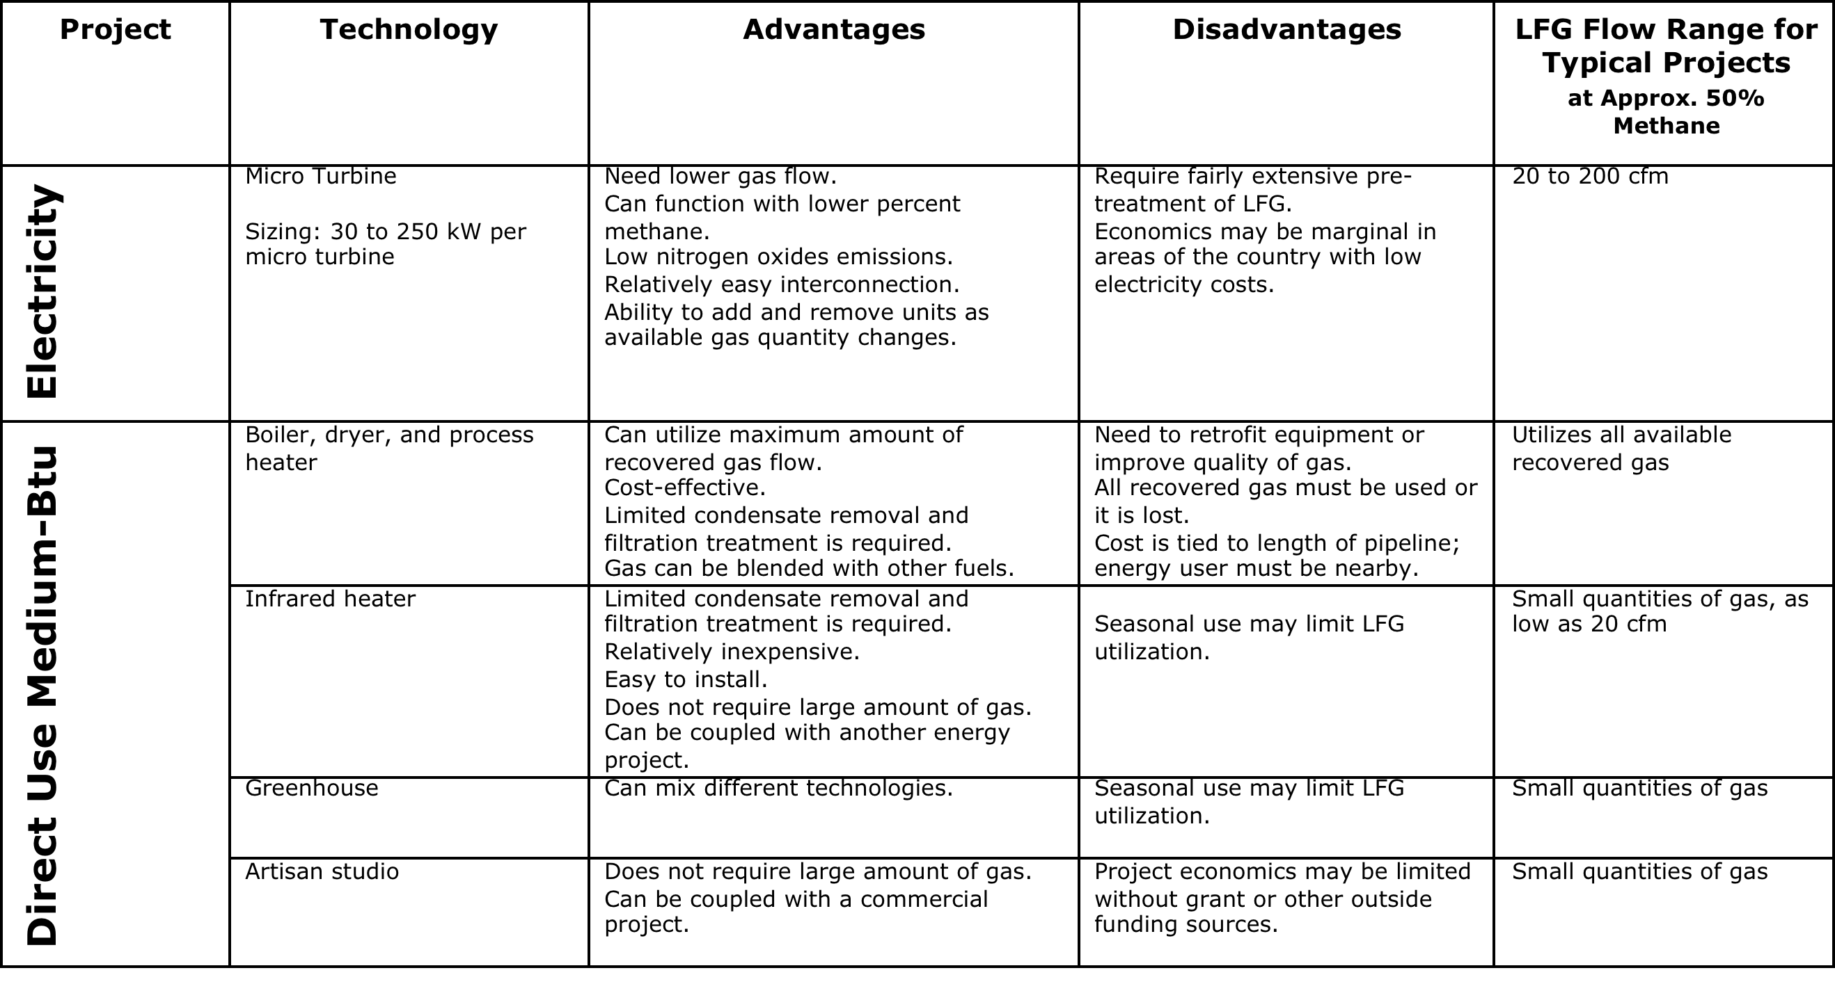
Further Examination of Technically Feasible Options: Micro Turbines and Direct Use

Slide 16
Projected Landfill Gas Emissions in Comparison to Micro Turbine Flow Rate Range

Slide 17
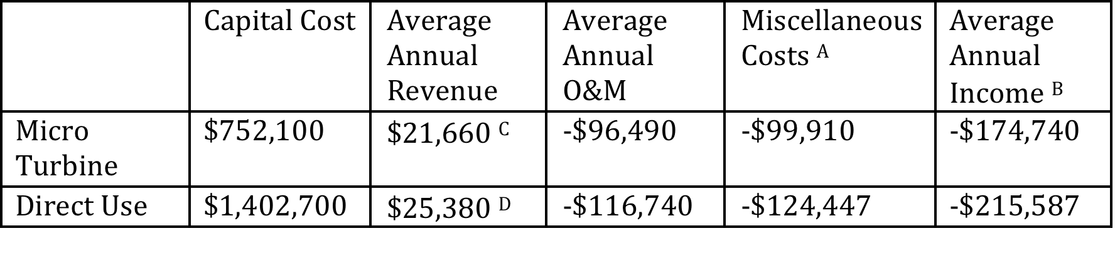
Financial Feasibility
Notes: Based upon Landfill Methane Outreach Program’s LFG Cost Tool
^{A} average yearly costs of e.g., taxes, depreciation, interest on loans, etc. The complete cost analysis spreadsheet can be found in Appendix B and C.
^{B} (average revenue) - (average O&M) - (Miscellaneous)
^{C} sales from electricity generation
^{D} revenue from sales

Slide 18
Summary
Only two systems were determined to be technically feasible
Micro turbines
Direct use
However, according to cost model, neither system produce a positive annual income

Slide 19
Questions?

Slide 20
Projected Landfill Gas Emissions for Sumter County
Estimated with US EPA’s LFG LandGEM model
First order decay model developed from empirical data with a decay constant (k) and methane generation potential of waste (L₀)
US Clean Air Act default values used
k = 0.5/yr
L₀ = 170 m³/Mg

